Slide 1

Name - Ishwa Roll no – S19CSE022 Branch – CSE Semester – 7th Sem Submitted to – Ms. Bhawna

Slide 2
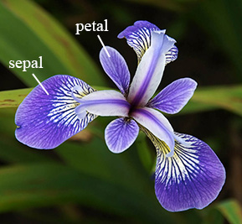
IRIS FLOWER CLASSIFICATION IN DATA SCIENCE

Slide 3
INDEX
INTRODUCTION
REQUIRENMENT SPECIFICATION
CONTENT IN PROJECT
OBJECTIVE
PURPOSE
SCOPE
PROCEDURE
ADVANTAGE
OUTPUT WITH CODE
CONCLUSION
REFERENCES

Slide 4
Introduction
The Iris Classification in data science is end to end machine learning project or data science project for iris flower classification. The aim of the iris flower classification is to predict flowers based on their specific features and separate different species and to identify them. It contains five columns namely – Petal Length, Petal Width, Sepal Length, Sepal Width and Species Type. All these lengths were in centimetres. And dependent feature, which will be the output for the model, is species. It contains the name of the species to which that particular flower with those measurements belongs. Iris is a flowering plant, the researchers have measured various features of the different iris flowers and recorded them digitally.
The Iris flower data set or Fisher's Iris data set is a multivariate data set introduced by Ronald Fisher in his 1936. It is sometimes called Anderson's Iris data set because Edgar Anderson collected the data to quantify the morphologic variation of Iris flowers of three related species. The use of this data set in cluster analysis ıs however uncommon, since the data set only contains two clusters with rather obvious separation.

Slide 5
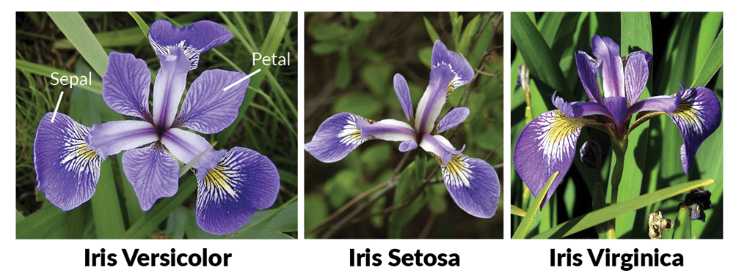
One of the clusters contains Iris setosa, while the other cluster contains both Iris virginica and Iris versicolor and is not separable without the species information Fisher used. It is multivariate(more than 2 dependent variable) data set Study of three related Iris flowers species. Data set contain 50 sample of each species(Iris-Setosa, Iris-Virginica, Iris-Versicolor)

Slide 6
REQUIREMENT SPECIFICATIONS
Hardware Requirement:
Processor Brand : Intel
Processor Type : Core i5
Processor Speed : 2.40GHz
Ram Size : 8.00 GB

Slide 7
Software Requirement
Operating system : Windows 10
Application Server : Anaconda
Language used : Python

Slide 8
CONTENT
The four features of these 3 types of flowers (Iris setosa, Iris versicolor, Iris virginica) are:
1)Sepal Length 2)Sepal Width 3)Petal Length 4)petal Width
We will classify the given flower by using this Four Features

Slide 9
Objective
The objective of iris classification in data science is to classify the flowers according to their traits. The central goal is to design a model that makes proper classification for new flowers. The iris data set contains fifty instances of each of three species. Iris Flower Classification is a Machine Learning Project. The iris dataset contains three classes of flowers, Versicolor, Setosa, Virginica, and each class contains 4 features, ‘Sepal Length’, ‘Sepal width’, ‘Petal length’, ‘Petal width’. The aim of the iris flower classification is to predict flowers based on their specific features and separate different species and to identify them.

Slide 10
PURPOSE
The aim of the iris flower classification is to predict flowers based on their specific features and separate different species and to identify them. The iris dataset contains three classes of flowers, Versicolor, Setosa, Virginica, and each class contains 4 features, 'Sepal length', 'Sepal width', 'Petal length', 'Petal width'. The aim of the iris flower classification is to predict flowers based on their specific features.

Slide 11
SCOPE
After the project has been settled, the computer should have the ability to aggregate three different classifications of Iris flower to three categories. The whole workflow of machine learning should work smoothly. The users do not need to tell the computer which class the Iris belongs to, the computer can recognize them all by itself. The final purpose of this project is to let everyone who read this thesis have a basic understanding of machine learning. Even through someone never touched this field, they can realize that the machine learning algorithm will become more popular and useful in the future. Moreover, the case study of Iris recognition will show how to implement machine learning by using Scikit-learn software. Become more popular and useful in the future. Moreover, the case study of Iris recognition will show how to implement machine learning by using Scikit-learn software.

Slide 12
Procedure
1. Import Library 2. Analyze Data 3. Splitting the Data Set into train and test 4. Choosing right algorithm for training model 5. Test the algorithm with test data.

Slide 13
ADVANTAGE
If the number of variables is large, it computes faster than other clustering algorithm.
User friendly
Simple and easy to learn – The concept of this programming language is as simple as it can be.
Open Source – python is completely free as it is an open source software. Users can easily install Python on their own computer and use the standard and extended library.

Slide 14
OUTPUT WITH SOURCE CODE

Slide 15
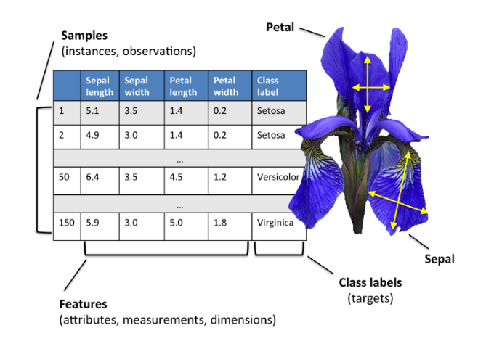
FINAL EVALUATION
Dataset

Slide 16
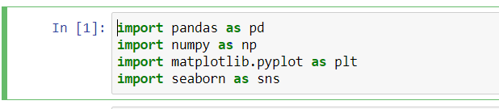
FINAL EVALUATION
Load the data
First, we’ve imported some necessary packages for the project.
Numpy will be used for any computational operations.
We’ll use Matplotlib and seaborn for data visualization.
Pandas help to load data from various sources like local storage, database, excel file, CSV file, etc.

Slide 17
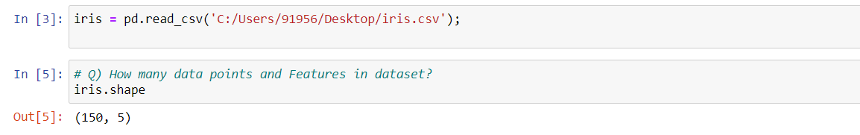
Next, we load the data using pd.read_csv() and set the column name as per the iris data information.
Pd.read_csv reads CSV files. CSV stands for comma separated value.
iris.shape shows how many data points and Features in dataset

Slide 18
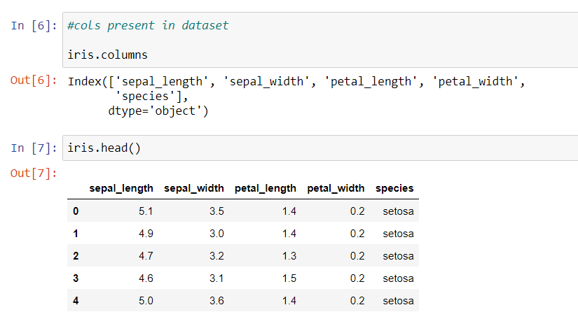
iris.head() only shows the first 5 rows from the data set table.
iris.columns shows columns present in dataset

Slide 19
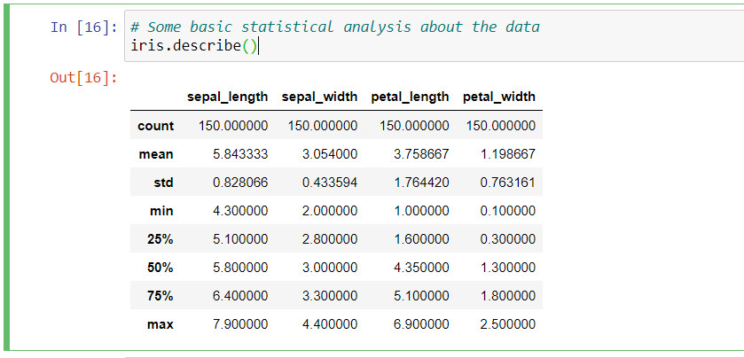
Analyze and visualize the dataset
From this description, we can see all the descriptions about the data, like average length and width, minimum value, maximum value, the 25%, 50%, and 75% distribution value, etc.

Slide 20
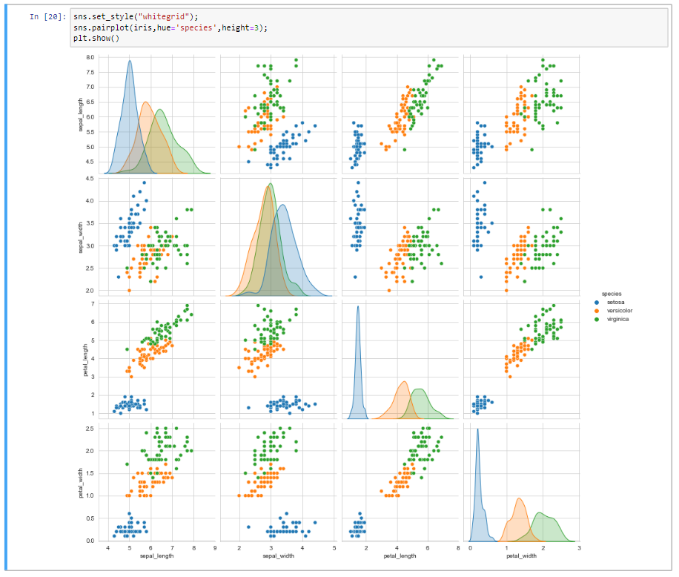
VISUALIZE THE DATASET
To visualize the whole dataset we used the seaborn pair plot method. It plots the whole dataset’s information.
From this visualization, we can tell that iris-setosa is well separated from the other two flowers.
And iris virginica is the longest flower and iris setosa is the shortest.

Slide 21
CONCLUSION
We can easily distinguish Setosa. Due to a lack of data, it is hard to distinguish between Virginica and Versicolor. In this project, we learned to train our own supervised machine learning model using Iris Flower Classification Project. Through this project, we learned about machine learning, data analysis, data visualization, model creation, etc.

Slide 22
REFERENCE
www.google.com
www.youtube.com
https://seaborn.pydata.org/generated/seaborn.pairplot.html
https://seaborn.pydata.org/generated/seaborn.FaceGrid.html
https://www.kaggle.com/arshid/iris-flower-dataset
https://www.datacamp.com/community/tutorial/machine-learning-in-r

Slide 23

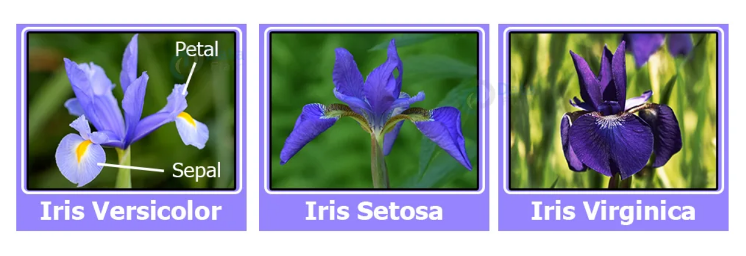
THANK YOU

